Slide 1
Technique tutorial – Happy Path First Modeling
Happy Path First Modeling
Systematic approach to process modeling
In order to increase process model quality
By reducing cognitive load

Slide 2
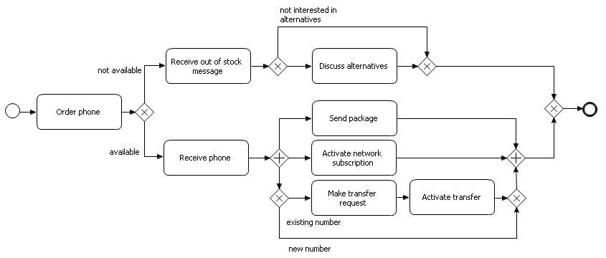
Technique tutorial – Happy Path First Modeling
Happy Path
One path from start to end that models the standard process flow

Slide 3
Technique tutorial – Happy Path First Modeling
Technique
First model the happy path from start to end
Only then, model the exceptional paths
Do not work on exceptions as long as the main flow is not modeled

Slide 4
Technique tutorial – Happy Path First Modeling
Steps
From the point you realize the process flow splits into multiple subpaths, look for the general flow and model that subpath first until the end, before working on the rest of the model.
Once you finished to model the happy path, start again at the beginning and look for exceptions. Work on these exceptional subpaths, one by one.
Combine steps 1 and 2 to construct the whole process model.
Whenever you come accross a new split: use rule 1.
Whenever that subpath connects to the model again, use rule 2 to model the exceptions of that subpath.

